Slide 1

Understanding more about traumatic Brain Injury (TBI)
Chris Kuehl
Regional Specialist of TBI
SWWC Service Cooperative
chris.Kuehl@swwc.org , 507-822-1025

Slide 2
What is a TBI?
An injury to the brain caused by an external physical force, resulting in total or partial functional disability and/or psycho-social impairment that may adversely affect a student's performance and result in the need for special education and related services. The term does not apply to brain injuries that are congenital or degenerative, or brain injuries induced by birth trauma. (MN Rule 3525.1348)

Slide 3
Types of Brain Injury
Traumatic
Falls
Motor Vehicle Accidents
Sports Injuries
Assault/Abuse
Military Blast Injury
Non-Traumatic
Stroke
Tumor
Lack of oxygen/ hypoxic
Meningitis/Encephalitis (infections)
Toxicity

Slide 4
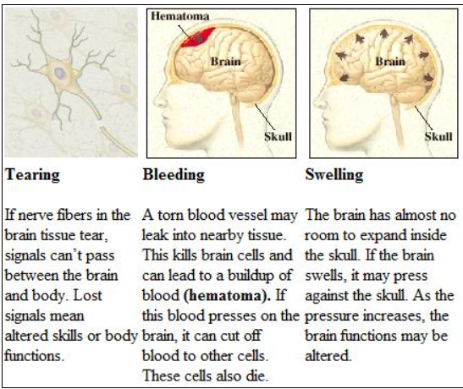
What happens to cause brain injury?

Slide 5
How the brain can recover
Brains cell or neurons repair themselves (mild injury…just need rest)
Through the power of plasticity, healthy portions of the brain surrounding injury can assume function of the damaged areas.
The brain rewires growing new pathways
Rehab: relearning of forgotten skills, learn compensating skills for more enduring impairments.

Slide 6
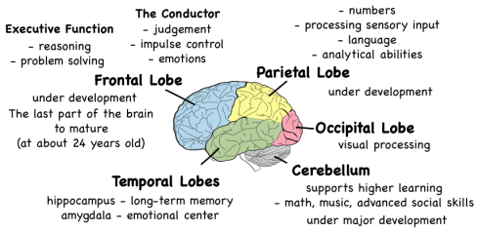
http://www.brainline.org/multimedia/interactive_brain/the_human_brain.html

Slide 7
How schools can support a student with TBI
Understanding what a TBI is. Awareness of what happened and support in helping them learn more how to help a child heal, cope, and advocate for themselves.
Academic Challenges: Organizational issues frequently occur after a brain injury due to the damage done in the frontal and temporal lobe.
Understanding Behavior Changes- since a student may look the same it is hard for others to feel empathy for them. It is a hidden disability. Instead of punishing kids we need to support them by teaching them new strategies.

Slide 8
After injury protocol
Return to learn/ Return to Play---2 different National protocols in place to support students.
Does your school have a person designated to be in charge of Return to Learn protocol? Usually the Athletic Director is in charge of Return to Play.
Note: input from health care provider is important to know how much a student can resume activities (reading, large group, movement).

Slide 9
Options to support students after tBI
504
Accommodations by school personnel
Refer to Special Education
Accommodations AND modifications.
Specialized instruction from SPED personnel

Slide 10
Recommendations
Before student returns to learn
A meeting is held with parents, teachers, support staff, Dr. (invite to zoom in or get written documentation of progression of steps to ease back to school) to inform team of health status and get everyone on same page.
Have a contact person at school that the student feels comfortable with to be advocate for student throughout the day.
Many forms/protocols available on any of the sites shown in this PPT to support transition back to school.

Slide 11
Return to Learn- www.cdc.gov
To start, identify the types of symptoms the student is experiencing.
Next, try to identify specific factors that may worsen the student’s symptoms so steps can be taken to modify those factors. For example: Do some classes, subjects, or tasks appear to pose greater difficulty than others (compared to pre-concussion performance)?
For each class, is there a specific time frame after which the student begins to appear unfocused or fatigued (e.g., headaches worsen after 20 minutes of reading)? Racket back: read 15 min./listen to text digitally.

Slide 12
Continued…..
Is the student’s ability to concentrate, read, or work at normal speed related to the time of day? (e.g., the student has increasing difficulty concentrating as the day progresses)
Are there specific things in the school or classroom environment that seem to distract the student?
Are any behavioral problems linked to a specific event or setting (bright lights in the cafeteria or loud noises in the hallway, a task, or other activity cause agitation/crying)?

Slide 13
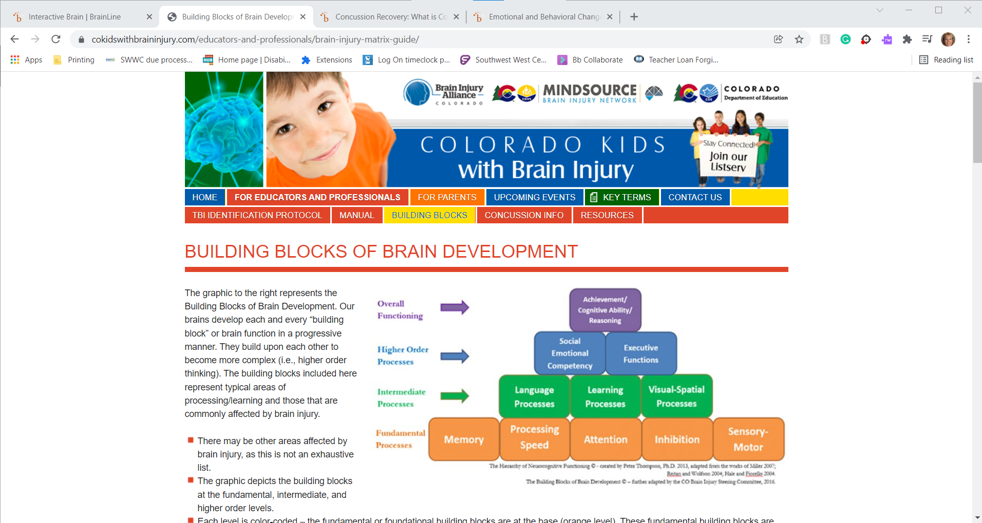
Academic Resources and supports
https://cokidswithbraininjury.com/educators-and-professionals/brain-injury-matrix-guide/

Slide 14
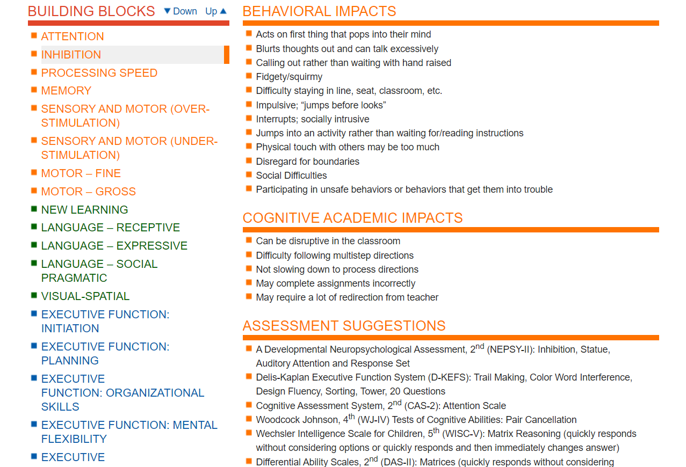
Academic Resources and supports
https://cokidswithbraininjury.com/educators-and-professionals/brain-injury-matrix-guide/

Slide 15

https://www.brainline.org/

Slide 16
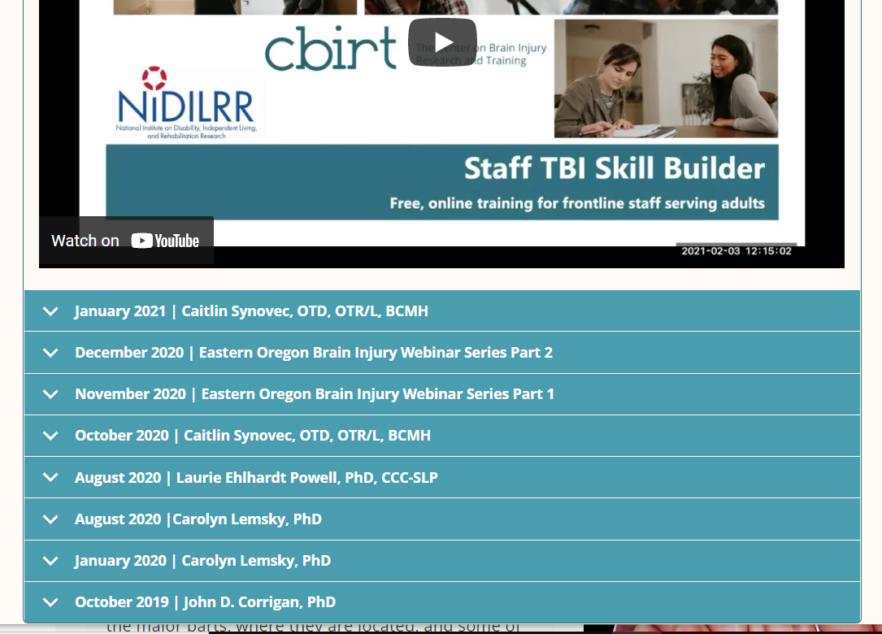
www.cbirt.org

Slide 17
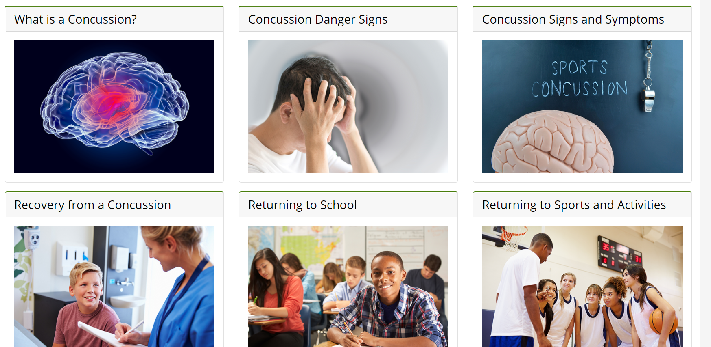
https://www.cdc.gov/headsup/index.html

Slide 18
Summing it up…
No two brain injuries are alike.
TBI is a hidden disability. Individuals may look the same, but they may be struggling socially, emotionally, academically, and/or physically due to their injury.
TBI impacts the whole family, listen to Josh’s story: 1 hour https://www.hennepinhealthcare.org/specialty/traumatic-brain-injury-center/

Slide 19
Thank you for listening!
Enjoy the day!

